Slide 1


III. Biases, fairness
Yet another problem

Slide 2
Final assignment
Maybe start thinking about it now
Look at the links in the first class to find datasets and some instructions
I have started correcting Lab 2, check out the GitHub for ideas in what you could do for the final assignment

Slide 3
Final assignment (reminder)
Find a messy dataset with at least 10 variables (features), and >1K observations (instances)
Have a quick look at the data
Find some question that you find interesting to answer and do a data analysis plan (see Class 1)
Clean the data: check for missing data, aberrant values, think about potential biases (if you feel up for it) (see Class 2, 3)
Do analyses to answer your question (univariate, bivariate, multivariate if needed) (See Lab 1, 2)
Interpret your results and do some data viz (see Class 4, Lab 3)

Slide 4
Job fair tomorrow
I’ll be there in the afternoon, come find me if:
You are looking for an internship in stats/data analysis in public health
You want me to look critically at your resume
You just wanna talk about something, idk 🤷‍♂️

Slide 5
Last chapter summary
In the last class, we saw the problems of bad quality and missing data
We saw what it was, different characterisations of missing data, and techniques to mitigate this problem (namely imputation)
Finally, we talked a bit about measurement errors

Slide 6
What we’ll do today
We will still talk about “bad data” but we will take a step back and think about all the processes that led us to have bad data
We will talk about fairness in statistics and Machine Learning
Notes:
This will involve looking at more complex situations and modelisation strategies to tackle these problems, rather than doing imputation or deleting data

Slide 7
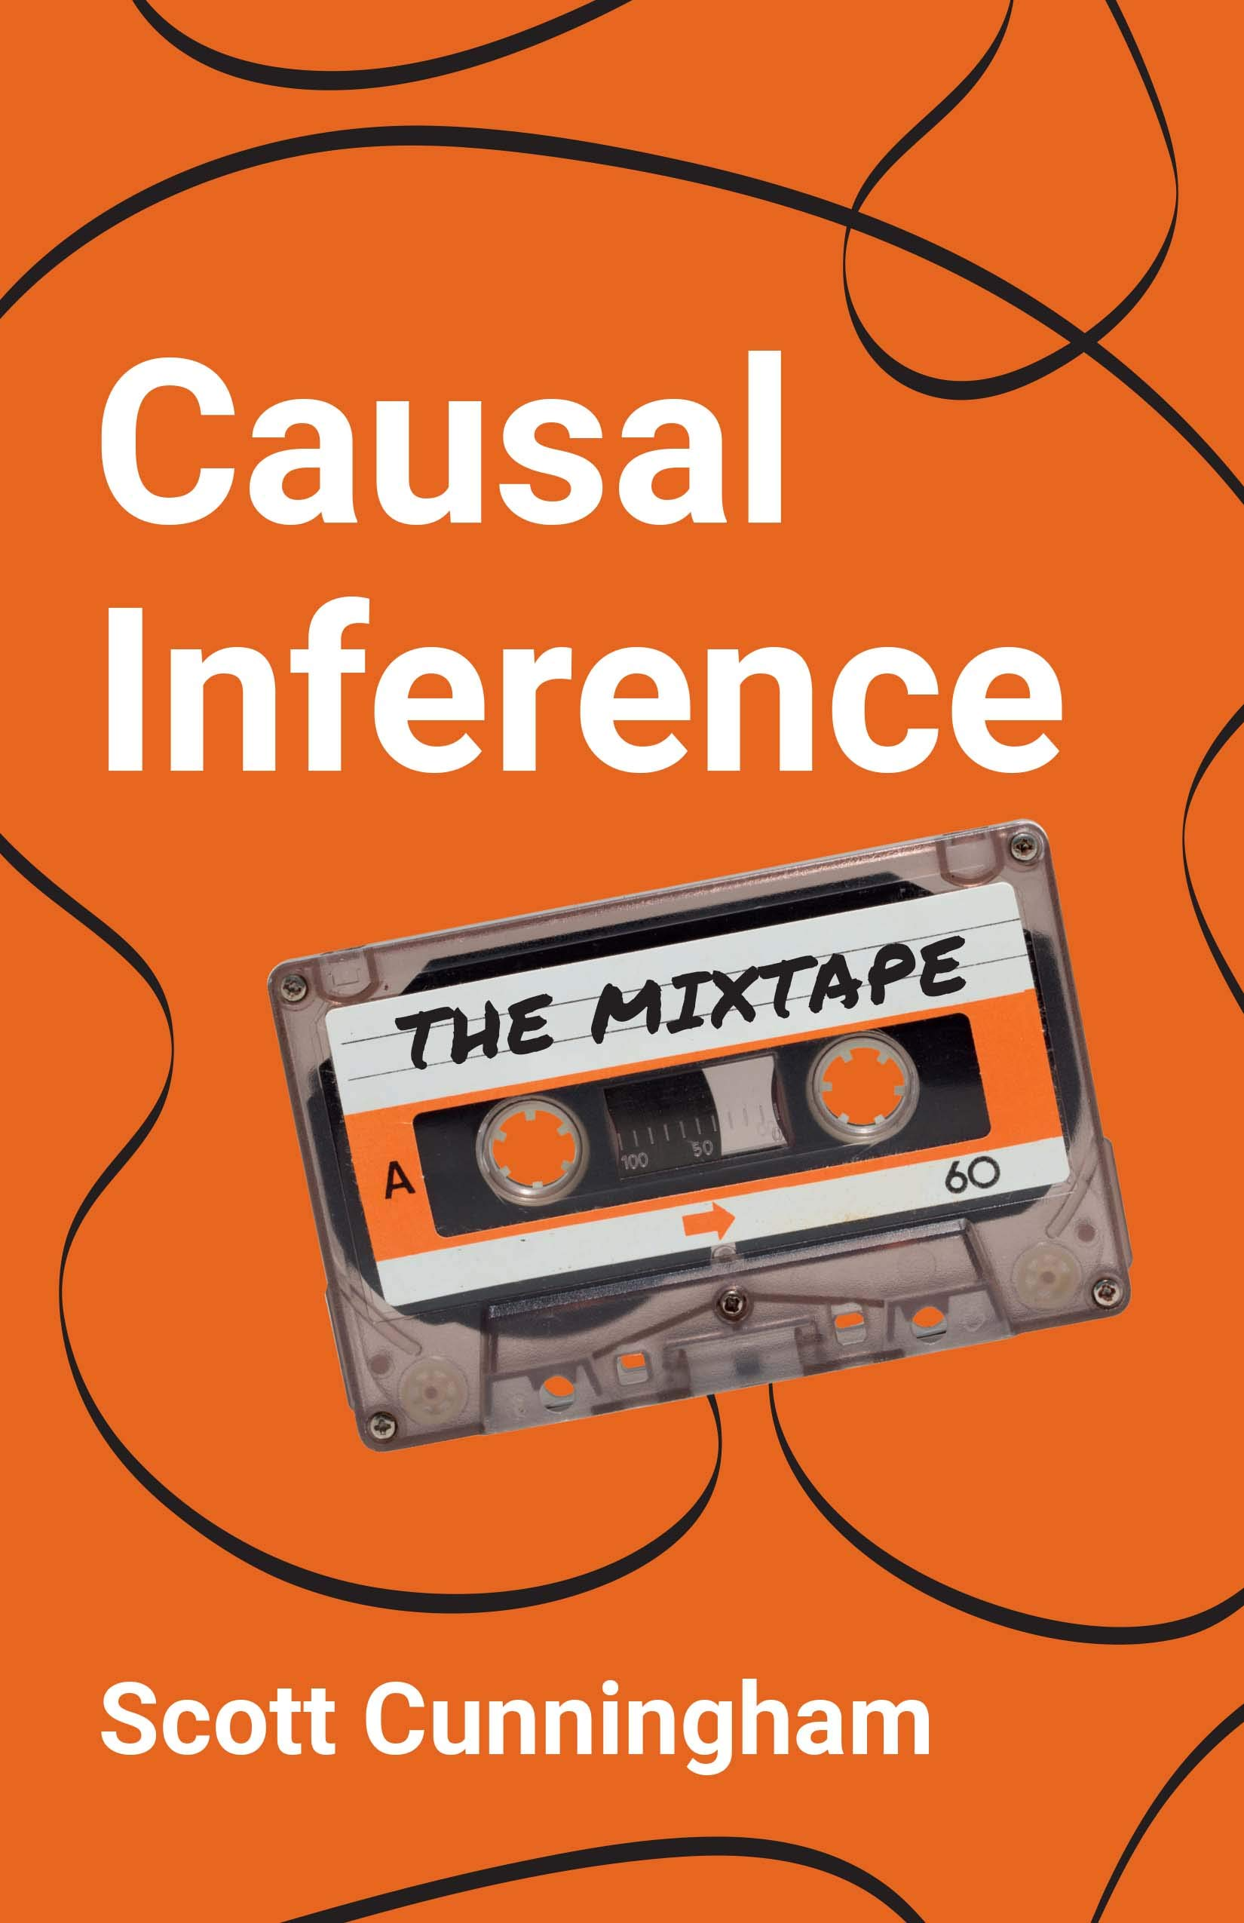
Resources
Causal Inference: The Mixtape Free here: https://mixtape.scunning.com/
Fairness and Machine Learning: Limitations and Opportunities Free here: https://fairmlbook.org/pdf/fairmlbook.pdf
Bias and Causation: Models and Judgment for Valid Comparisons

Slide 8
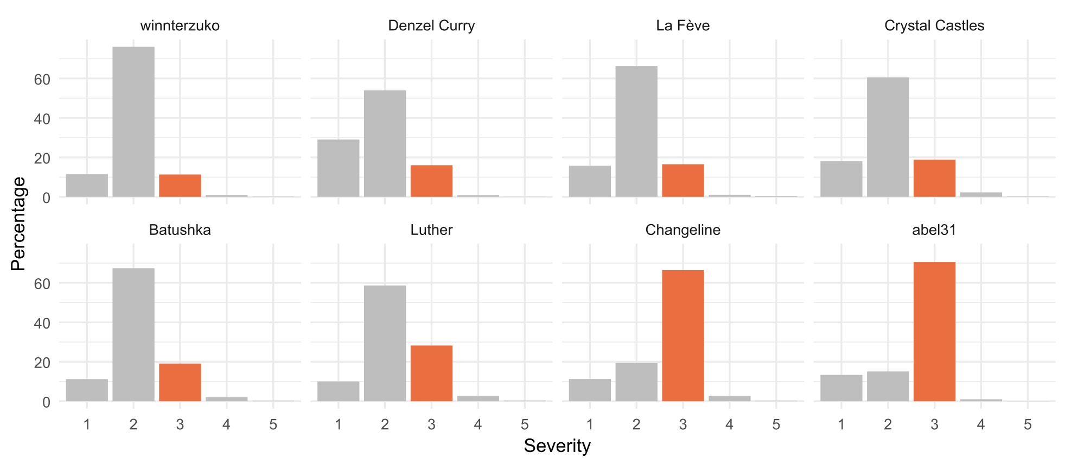
Bias (1)
During the last lab, you had to verify the distributions of some variables
100% of you missed the measurement bias on the “severity” variable in the lab exercise in some emergency services. Unless I told you about it.

Slide 9
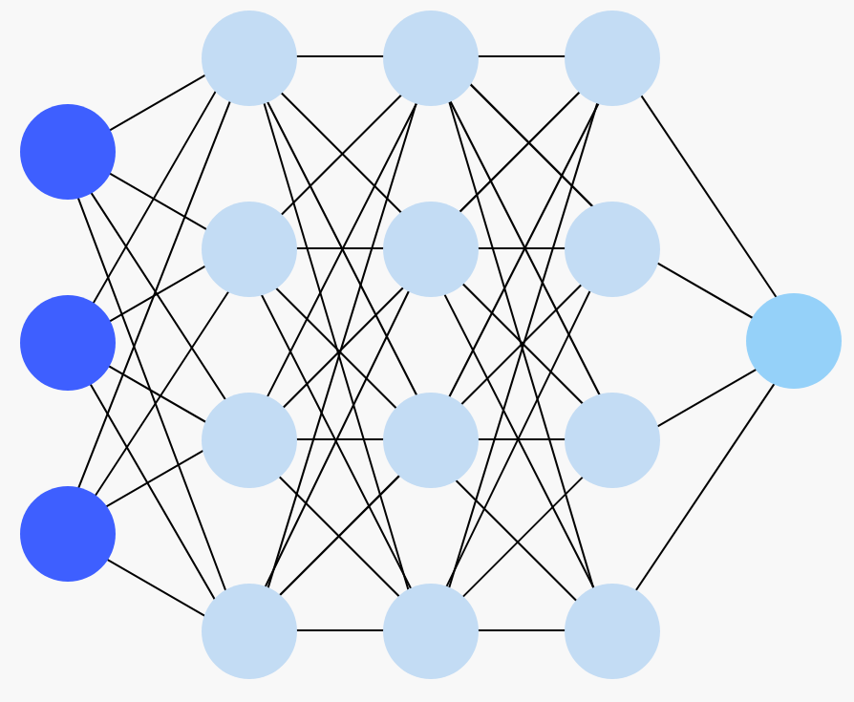
Bias (2)
This is one of the most challenging and critical issues you will find in your work:
You can’t just solve it by throwing at it
This requires research and expert knowledge on the data and how it is gathered
These will be issues in your descriptive and modelling stages
What if the only data you had were these services? You wouldn’t even be able to observe this through data analysis
Notes:
In my opinion, it will be the second biggest challenge. The first one we will see it next course.

Slide 10

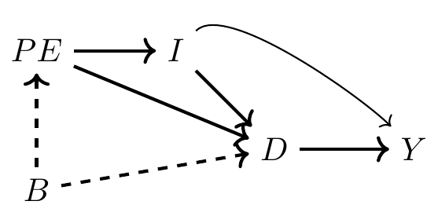
The big picture: causality…
Always has been
Bias is (un)fortunately linked to causality
This takes whole courses, not just 20 minutes slides
causality
Wait… it’s all Ohio?
For great introductions, check out:
Causal Inference: The Mixtape, by Scott Cunningham
Especially the chapters on Directed Acyclic Graphs (DAG), backdoors, colliding and confounding variables… this will make you think twice about what you put in your models
Causal diagrams: draw your assumptions before your conclusions
Also: Antonakis et al. 2010
Sorry.

Slide 11
Causal inference (1)
X
Y
At its core, causal inference is simply estimating the true impact of some event, policy, choice, attribute (i.e. some X variable) on an outcome (your Y)
The challenge here is disentangling the true effect of X on Y from any other possible interference
Typical example: you want to know the effect of a vaccine on some disease
How would you do that?
Notes:
Interference: variables that affect or are affected by both X and Y

Slide 12
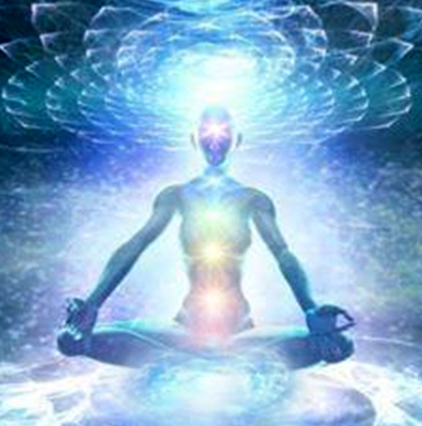


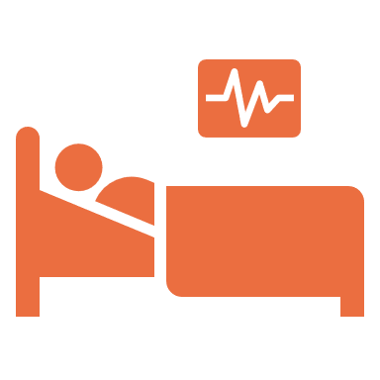


Causal inference (2)
If you were a godlike being, you would just create two identical universes: one where you take the treatment, one where you don’t
Universe A
Universe B
Very healthy
*It’s a vaccine, not steroids.

Slide 13
Causal inference (3)
Unfortunately, you can only observe one situation
The key (and difficulty) of causal inference is finding a valid comparison
We call that a counterfactual (what would have happened in the other situation)

Slide 14













Causal inference (4)
A way to do this, is to create two groups with similar characteristics (to be defined!) such that no (un)observed characteristic is correlated with both assignment to a group and the outcome of interest
Randomisation is a good starting point, if you can! (hence, why Randomised Controlled Trials are called the “gold standard”)
Group A (Treatment)
Group B (Control)
Notes:
So what does this mean really? Give example of giving a vaccine only to women, and the men are the control. Why wouldn’t it work?

Slide 15
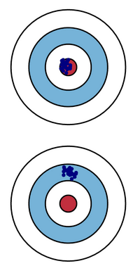
Bias
In your typical econometrics course, bias is the properties of an estimator: it is biased if, on average, it yields parameters different from their true values
This is not due to the data, this is a property of the estimator itself
Here, we will consider bias as a systematic distortion of some causal effect, coefficient, or measurement of a variable, that make them different from their true values
Rather than an estimator property, this here is due to methodological problems (during data gathering, analysis…)
Notes:
Ask students if they know of a biased estimator? Biased estimators: think shrinkage estimators, like lasso, ridge… Sometimes you can get more accurate predictions using methods that yields purposely « wrong » coefficients!
Systematic is key: you can have random bias, just a random distortion in some observations. Here, the subject is a distortion that is systematic: people that systematically report a wrong answer, a machine that is ever so slightly broken that it systematically underestimates or overestimates its measurement…

Slide 16
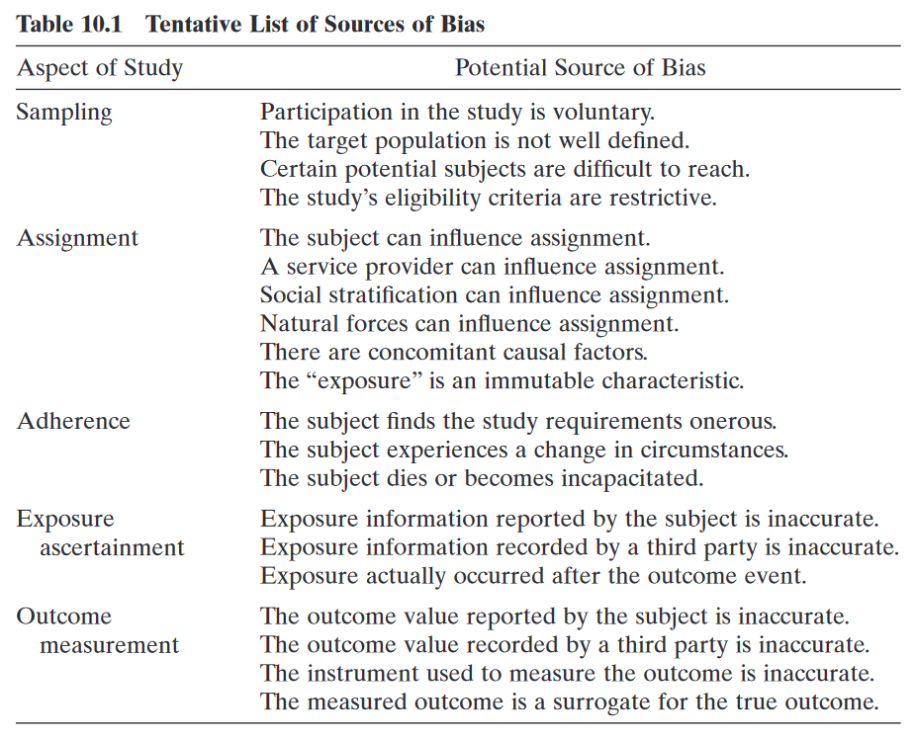
A Taxonomy of bias
1
Weisberg (Bias and Causation book) proposed a taxonomy of the main families of bias
Left: family
Right: examples of sources
2
3
4
We saw these ones last time (I call that measurement error)
5

Slide 17
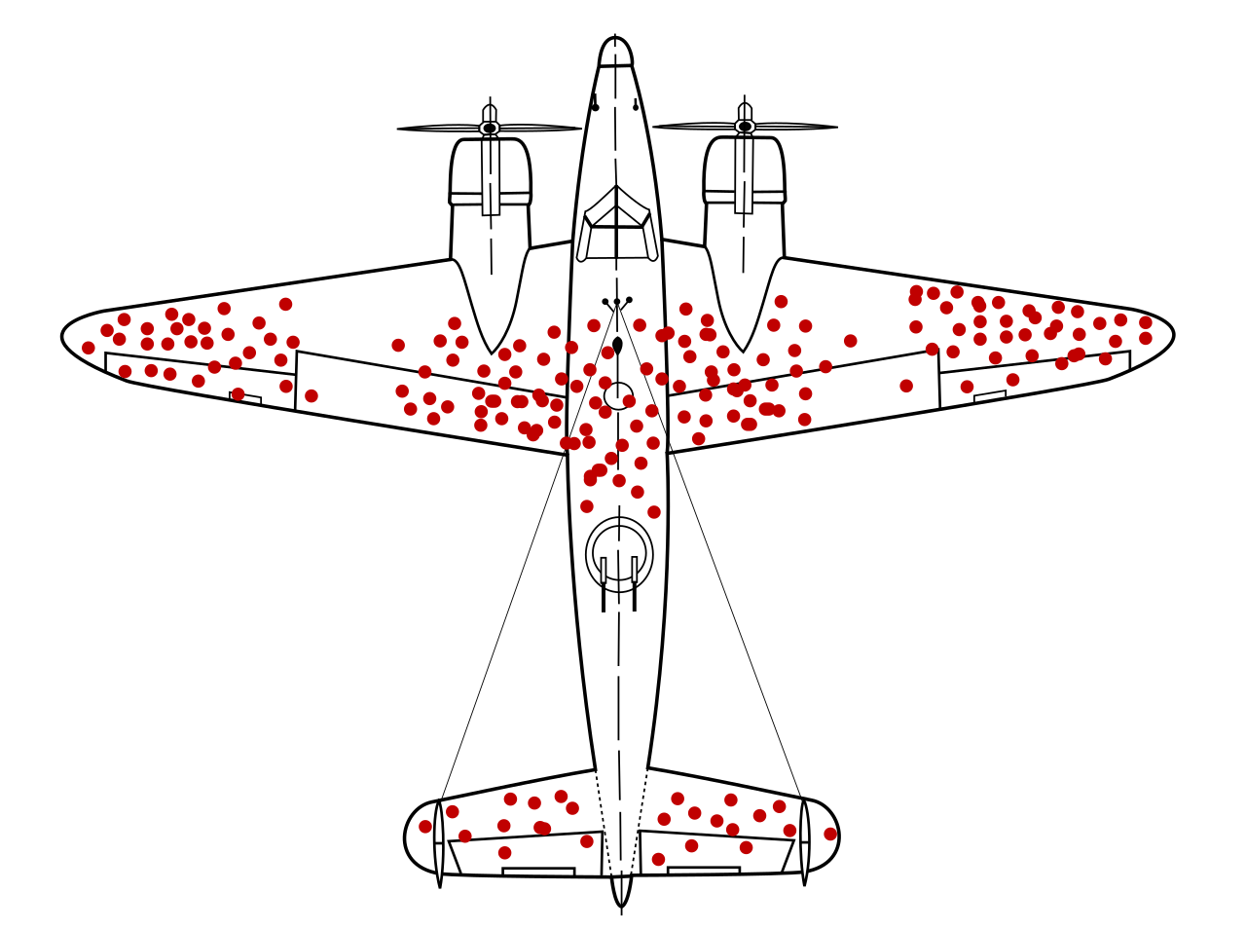
That one example with the plane
It’s World War II, and a bunch of planes came back. Red points refer to positions where those planes were hit.
Where would you put additional armor to better protect the planes?

Slide 18
What’s a sample?
1
In statistics, we are often interested in discovering characteristics and patterns in some population
In reality, you are unlikely observe every person/object/entity in your population
Too costly, too long, too complicated…
Imagine if you had to interview 60 million people in France whenever you want to conduct an election poll
A way to remedy this: we take samples, subsets of this population
Notes:
Most data sets will be sample from a population

Slide 19

Sample selection bias
1
Your sample should look like your population… but what if it doesn’t ?
That is sample selection bias: the analyses can be valid for your sample, but cannot be generalized to the whole population
Worse: you may find correlations within your sample that are not present in the population
Accidental selection bias
You can create this problem yourself when you incorrectly split your data in two train-test datasets.
Make sure your splitting is random (or, ideally, stratified) and that the two samples are somewhat similar
Notes:
That’s a big problem, because in the first place, you want to gather information about the population. You are not interested in the sample in itself, that is just a convenience, you are interested in the whole population.

Slide 20

An example through questionnaires
1
You send a questionnaire on workplace diversity, equality and inclusion (DEI) to a firm. This is the data you observe for one question
Are you favourable to hiring quotas?
(i.e. having a minimum percentage of workers with specific sociodemographic characteristics)
Disagree
Agree
Notes:
Master 2 internship thesis (in another master programme (: )
Subject was about discrimination in the workplace, gender-based violence, inclusivity, etc.

Slide 21
1
Are you favourable to hiring quotas?
(i.e. having a minimum percentage of workers with specific sociodemographic characteristics)
Disagree
Agree
Logistic regression (Dependent variable = favourable to quotas)
Variable | % (sample) | % (population)
Gender
Men | 40 | 60
Age
-40 | 65 | 40
40-60 | 15 | 20
+60 | 20 | 40
Variable | Adjusted Odds Ratios
Gender (ref. women)
Men | 0.98
Age (ref. -40)
40-60 | 0.91**
+60 | 0.84***
Notes:
What do you think about these results?

Slide 22
Directed Acyclic Graph (DAG) time
1
This is a case of colliding bias
When two variables cause a third one, you do NOT want to condition on it: it distorts the association between the first two variables
But here you are forced to condition on participation to the questionnaire, because you cannot observe people that do not respond
Participation to questionnaire
Causes
Causes
Gender
DEI favourability
Notes:
That thing is a DAG. It’s used to represent causal relationships.
Here: men could be less likely to respond to questionnaires in general, and less likely to have a positive opinion to DEI topics. Likewise, people unfavourable to these topics will be less likely to respond to the questionnaire.
You are less likely to observe men, and people unfavourable to DEI in your sample
Participation to questionnaire is like a variable you are FORCED to include

Slide 23

1
Are you favourable to hiring quotas?
(i.e. having a minimum percentage of workers with specific sociodemographic characteristics)
Disagree
Agree
This could be the true distribution of the variable if we observed the whole population. What may possible be at work here:
Sample selection bias
Self-selection bias: people select into taking the questionnaire
Social desirability bias: tendency to provide socially favourable answers to conform to perceived social pressure (i.e. you respond what you feel you are expected to respond)
Fun thing: a lot of biases intersect. You can have multiple problems happening at once.
Notes:
Self-selection bias: whenever there is a decision to participate, there is usually a whole mechanism that lead you to this decision, based on your personal values, opinions, behaviours… This is why we usually use randomization, and frequently recall people to participate.

Slide 24
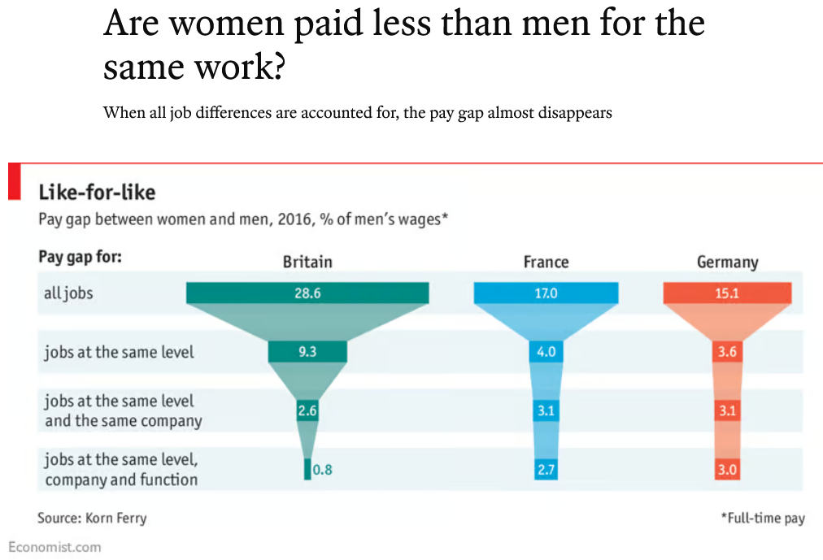
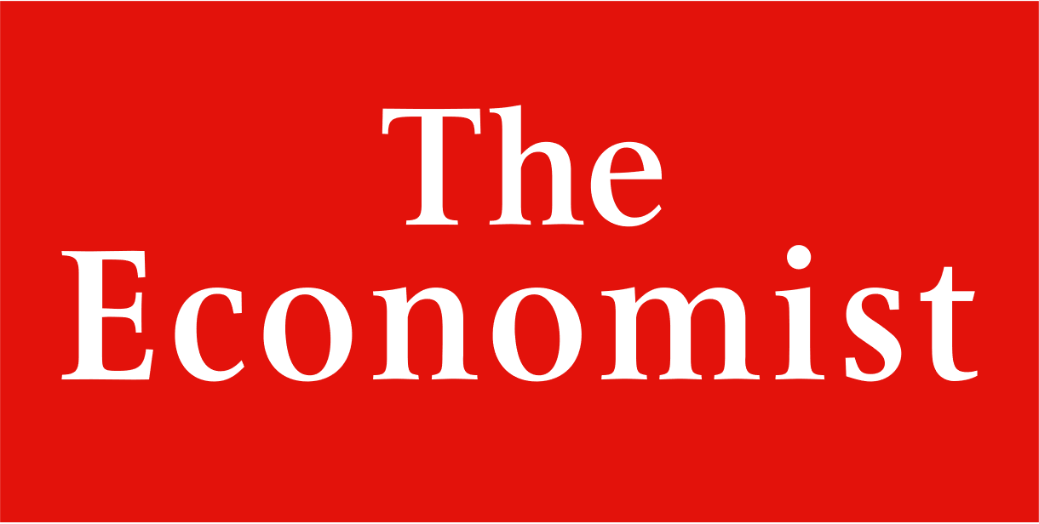
A word on colliding
Quite counterintuitive concept: you can introduce bias by including more variable into your analysis.
Classic example: the gender pay gap.
(2017 article)
mdr
Notes:
This is something people struggle to grasp: including more variable may not « reduce » bias, it can make it even more apparent.

Slide 25
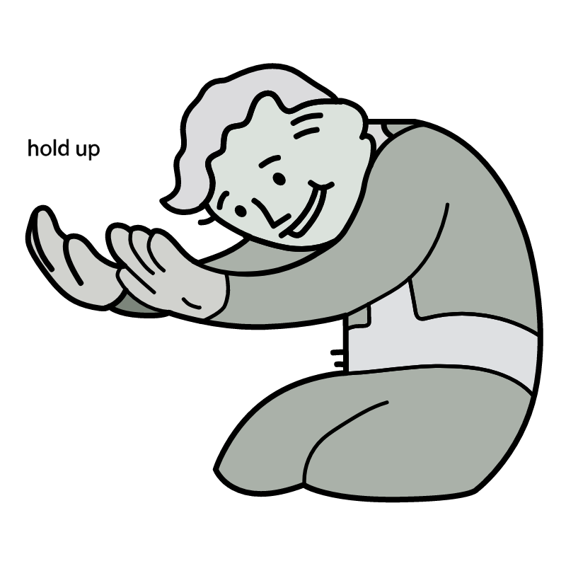
Ok so no discrimi—
Example of colliding bias in Causal Inference: The Mixtape using simulation data.
Data generating process:
Ability ~ N(1, 0)
Discrimination = Female = 1
Occupation = 1 + 2*Ability – 2*Discrimination + N(0, 1)
Wage = 1 – 1*Discrimination + 1*Occupation + 2*Ability + N(0, 1)
Causal effect of discrimination on wage should be -1 in this model.
Notes:
Four components in this toy model: innate ability, discrimination (0/1), Occupation, Wage
1: innate ability, totally random
2: all women experience discrimination
3: Occupation is better as ability increase, but worsens when faced with discrimination
4: Wage decreases with discrimination, increases with better occupation and ability. That is what we want to estimate!

Slide 26
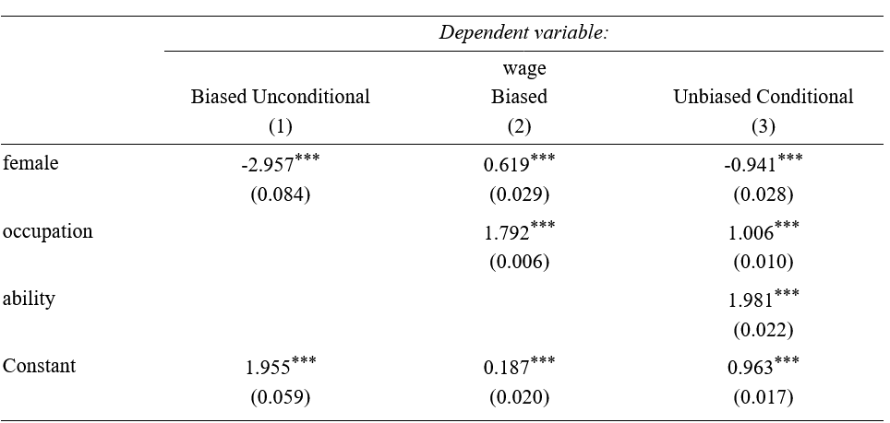
First regression: naïve
You get the total effect of being female on W
Discrimination
True model:
Ability ~ N(1, 0)
Discrimination = F = 1
Wage = 1 – Discrimination + Occupation + 2*Ability
Occupation = 1 + 2*Ability – 2*Discrimination
Female
Wage
Notes:
So the naive method: you just take your wage as a dependent variable, include discrimination (or female var, it’s the same thing), and regress.
You get -3. You know it is biased, because in the true equation it should be 1. So you get two effecs in one: the true effect of discrimination on wage, and something else…

Slide 27
Second regression: with occupation
Sign gets flipped: women actually earn more than men!
Discrimination
True model:
Ability ~ N(1, 0)
Discrimination = F = 1
Wage = 1 – Discrimination + Occupation + 2*Ability
Occupation = 1 + 2*Ability – 2*Discrimination
Female
Wage
Occupation
Ability
Notes:
First, occupation has an effect on wage. But in the model, discrimination also affects occupation. So discrimination has a direct effect on wage (Discrimination -> Wage), and an indirect effect through Occupation which acts as a mediator (Discrimination -> Occupation -> Wage).
However, in this model, ability (which is unobserved) affects both occupation and wage. If we include occupation, it now acts as a collider variable between Discrimination and Ability, and the correlation between wage and discrimination becomes spurious because we need to control for ability (it’s effect on wage is now in both the female and occupation coefficients). This is a type of omitted variable.

Slide 28
Full model
Discrimination
True model:
Ability ~ N(1, 0)
Discrimination = F = 1
Wage = 1 – Discrimination + Occupation + 2*Ability
Occupation = 1 + 2*Ability – 2*Discrimination
Female
Wage
Occupation
Ability
We find back the original equation of Wage in the true model.
Morality: think twice before including variables
Notes:
Now in reality, we don’t observe ability. Which is why estimating the GPG is a lot harder than this toy model.
This is only due to Ability -> Occupation. If you excluded ability from the equation of occupation, you would get the true effect of discrimination on wage only by including the occupation variable! The model would be less precise (i.e. more variance), because you don’t take into account ability, but the coefficients would still be unbiased!
The point is: you may introduce even more bias by including some variables.

Slide 29

Assignment bias
2
Let’s say you want to implement a job training program and see its impact on wage
Enrolment is voluntary, people decide to undertake training, and you create some control group of people not undertaking it
You now have your two groups, and you compare the average wage between both a few months after the training has ended
Do you think you estimate the true effect of the training on wage?
Problem: there could be characteristics that lead people to select into training (motivation, resources or lack thereof, information…)
💸 💸 💸 💸 💸
Notes:
In this case, you can’t know if the effect of the training variable on wage is due to the training itself, or due to some other characteristics of the training group that led them to undertake training.

Slide 30
Assignment bias
2
Assignment into groups should be random if you want to measure a causal effect, the people between the two groups should be exchangeable
Sometimes you can’t avoid it!
This is why it is very hard to measure things like discrimination (based on gender, race, ethnicity…)
If you want to measure that, you need to compare people from one group to the other
But people will inherently belong to one group or the other, you can’t mimic random assignment, and they might not be exchangeable!
Notes:
On top of that, being of a certain stratum of society may be correlated with other unobserved variables, etc. etc.

Slide 31
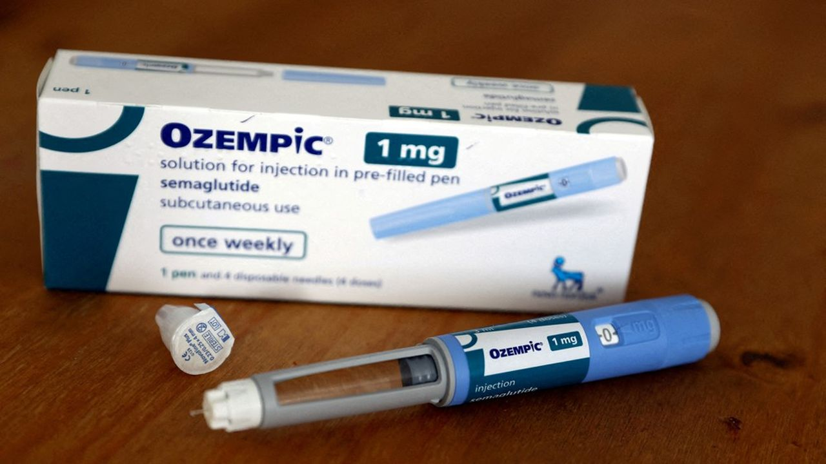
Adherence
3
This one is more about experimental designs
Imagine you want to analyse is the impact of taking Semaglutide (Ozempic, Wegovy) on weight. The 6-month protocol specifies:
Subcutaneous injections twice a day
Weekly appointment to a lab for a blood test and weight measurement
You take random samples of 10k people that will receive Semaglutide, 10k people that will receive a placebo

Slide 32

Don’t wanna do it anymore
3
Compliance with the protocol is paramount. But many things can happen in a 6-month span:
Participants can decide to not take any medication, or less of it (1 injection instead of 2)
Participants can involuntarily stop taking the treatment: random life problems, side effects of the drug…
Or… die
So… treatment is not the same among everyone!
Analyses can be made on:
The fully compliant subset. May be biased, since the selection is not random!
Everybody (an “intention-to-treat” analysis). Here, you also include the effect of non-compliance on the outcome, through the treatment variable.
Notes:
ITT can be viable IF the factors leading to lack of adherence in the study are similar to those in the real world (possibly, reasons that lead participants to not comply to a treatment in a study will be the same among patients in real life).

Slide 33
Measurement errors
5
4
Measurement error is a general term for incorrectly measured variables, Weisberg distinguishes two cases:
Exposure ascertainment: distortion in the treatment variable, the one for which you want to know the effect on the outcome
Outcome measurement: distortion in your dependent variable of interest, your outcome
We will see a few examples of situations where people may not respond correctly or transmit wrong data
X
Y
Notes:
It comes actually in a lot of different forms

Slide 34

Recall bias and social pressure
5
4
Never underestimate how people are likely to have problems recalling things (recall bias) and to be subject to social pressure and expectations
Imagine I asked you how many times, in the last two months, you have been binge drinking (5+ drinks over a few hours) :
Depending on your alcohol consumption, you may not remember the true figure
Heavy drinkers may be likely to underreport their alcohol consumption due to social stigma
Notes:
Non-drinkers, or people who drink occasionally, I would expect a true response. ➔ Possible underestimation of the true prevalence of binge drinking

Slide 35
Desirability bias
5
4
Another similar example: in 2017, we asked nurses who got vaccinated against influenza how important was patients’ safety and collective protection in their vaccination decision, on a scale of 1 to 10
Average answers were around 9/10
You could argue it is their job, but it is possible they feel expected to give a high answer, as this is how we expect nurses to act
This is why, sometimes, too direct questions do not work
A better indicator on how nurses value patients’ health would be to ask multiple behavioural questions related to patients’ health and build a latent variable

Slide 36
Incentives
5
4
Earlier in the class, I showed you a measurement error in severity variables reported by emergency services
If you wanted to measure the true effect of disease severity on length of stay in an emergency service, you could not:
Some services have a financial incentive to overestimate the severity of some patients’ diseases
The effect of severity on length of stay becomes distorted

Slide 37
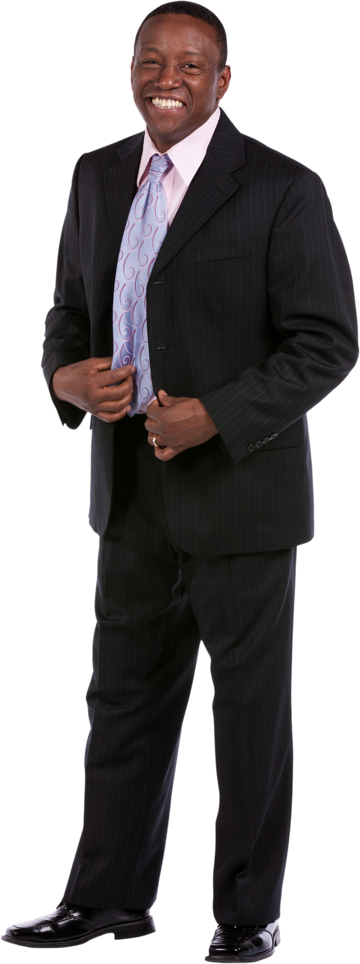
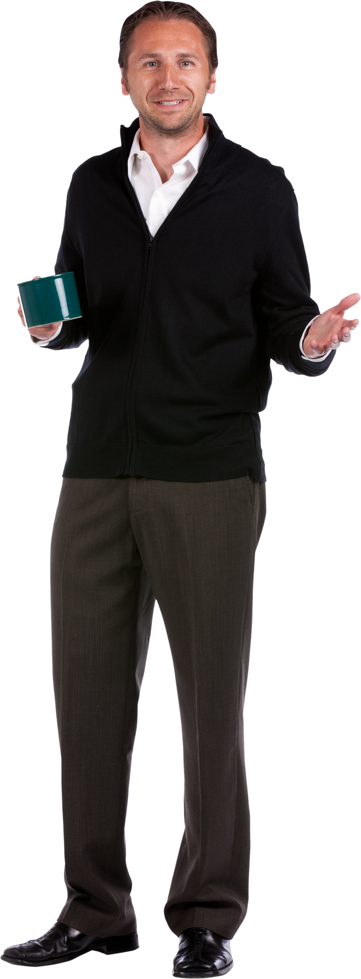

Proxy reporting
5
4
A proxy is an intermediary, a substitute
Let’s say you want to gather data about Roger, but you can’t ask him directly (he is not there, He is sick…)
Solution: look for a secondary source, like his roommate Alain, or his mother Solène
Problem: they might not know the “real value”… or might (un)consciously lie about it
You must include this proxy in your modelling (as a binary variable, for example)

Slide 38
The CARE study
5
4
DREES: CARE study (Capacités, Aides et Ressources des séniors)
Goal: assess seniors’ needs for help in their activities of daily living (health-related if they need help eating, showering, etc. etc.) and if their needs are met
The DREES sends people to administer a questionnaire to seniors at their home
Some cannot physically answer, for health-related reasons
In this case, they ask their spouse, children, or friends
What do you think would happen if we just didn’t bother interviewing them?

Slide 39
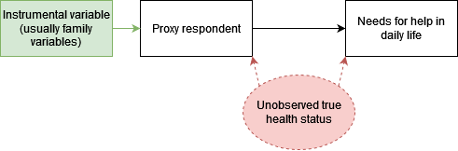
Proxy reporting: example
5
4
For each senior, we want to know if they need help in their daily life, and if their needs are met
Proxies were usually the caretakers of the person we wanted to interview
What do you think happens when you ask a caretaker questions about the people they care for? Notably:
How much help they need
How many of their needs are met
Unsurprisingly, proxy respondents overestimate both

Slide 40
Proxy reporting: example
5
4
Also, there’s endogeneity
The unobserved true health status is called a confounder, here
Omitted variable bias: health status influence both usage of a proxy, and the needs for help in daily life (and will be reflected in both coefficients if you don’t include health status)
Notes:
It’s also called a confounder variable: if it is not included in the analysis, it creates spurious correlations between the variables it determines

Slide 41
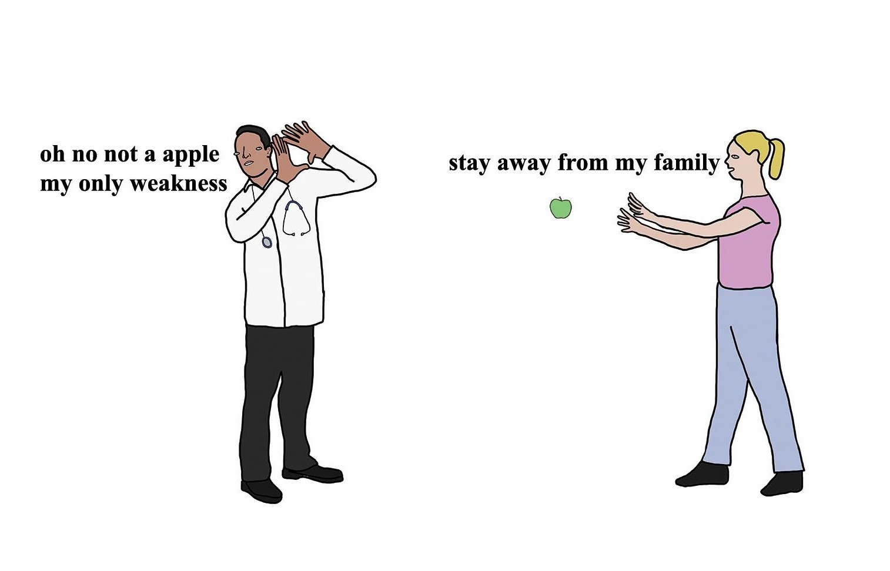
Solutions to bias
Best solution is prevention: proper randomization, careful selection of target population, procedures to avoid measurement errors, pilot testing questionnaires, verifying your data collection tools...
Some bias may only be solved by proper planning: for example, if you know there will be a measurement error in one of your variable and you need to gather an instrumental variable for it
There are way too many solutions that are context or industry-dependent to give an exhaustive summary here of how to tackle bias
Nevertheless, Weisberg (again) give some broad families of solutions for you to follow
From Chris (Simpsons artist)
Notes:
I won’t list ALL of them, some are quite difficult (and I don’t feel technically good enough to vulgarise the most complicated ones), but you’ll get those that are perfectly doable by junior DS.

Slide 42
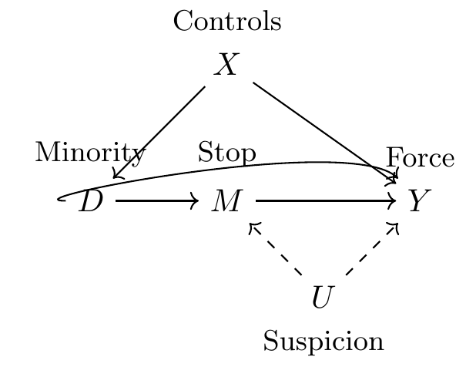
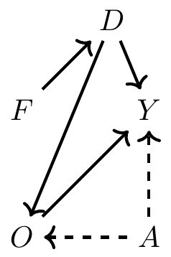
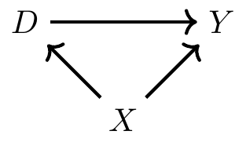
Back to the drawing board
1
You suspect you have some bias problem in your data?
Take your eyes off the data and do a DAG (those diagrams we saw earlier)
See Causal Inference: The Mixtape for a full and easy explanation on how to do one
The point is to have a clear map of the assumptions and relationships you suspect in your data
Notes:
Plus it is also a good communication tool. It’s not really popular in econometrics for some reason (and I don’t know why)

Slide 43
Take it step by step (1)
2
Another tip if you suspect confounding or colliding:
Instead of only fitting your full model, add variables one by one
Be wary of the sequence you follow to include variable
Notes:
Here, if you included ability first instead of occupation, you would have a different bias in the female & ability variables (they would both include indirect effects: occupation on wage through being a woman, occupation on wage through ability)
You can have a look at how coefficients vary as you add your covariates

Slide 44
Take it step by step (2)
2
An alternative:
Estimate your full, final model
Fit another one, with other (or new) candidate confounders while keeping your variable(s) of interest
Check how the coefficients on your variable(s) of interest vary
If they do, keep the new model, otherwise keep the initial one
Do note that, underneath this approach, there is the (untestable) assumption that your full model (or the competing one) is correct!

Slide 45


Weighting (with sample weights)
3
The idea:
You have a sample from some population, but it is not representative of it, or you have two groups (e.g. control and treatment) which are different
Goal of weighting is to assign weights to individuals such that some of them “matter” more or less than others in analyses
Sample
Sample weights
(i.e. each individual counts for)
Population
1.25 individuals in the population
5 individuals in the population
Notes:
Sampling error can happens even with stratified sampling (i.e. sampling people randomly according to some characteristics, like gender, age, socioeconomic status, etc.)
It’s a simple example but this can be done on multiple variables

Slide 46
Weighting (with sample weights)
Very versatile: use that whenever you want a group of observations to look like another group of observations
Example: non-response in a longitudinal survey? You can use weights to correct this, such that the respondents look like all the respondents at the beginning on the survey, on the characteristics you like
Using sampling weights requires specific methods for data analysis: see survey package on R
Caveat: you need to know what the other group (or your population) looks like
Notes:
Ex in a longitudinal survey: the most busy people stop responding at some point. If you can identify who they were, you could add more weight to the busy respondents that still respond.

Slide 47

Weighting (with propensity scores)
You can create weight that represent for probability of being into a group conditionally on some characteristics
This is the idea behind propensity scores, and inverse probability weighting
You model the probability of being into one group (group A, for example)
So if you hear about propensity score matching in one of your classes, this is one of the ideas behind this method:
The “matching” part being: you match people from both groups that have close probabilities of being assigned to group A, because they are comparable!

Slide 48
Limits to weighting (1)
Your sample will become representative of the population on the variables you selected to create weights
This may increase representativeness on other variables, if these are correlated with the variables you weight on…
Or the opposite:
Sample
Sample weights
(i.e. each individual counts for)
Population
1.25 individuals in the population
+
+
+
+
+
-
-
-
-
-
-
-
5 individuals in the population
(biased if you don’t take into account the +/-)

Slide 49
Limits to weighting (2)
This becomes a problem when the variable you do not take into account in your weighting is correlated with what you want to measure
There is a fancy name for this: the Conditional Independence Assumption (CIA)
Sample
Population
+
+
+
+
+
-
-
-
-
-
-
-
Notes:
Note: you cannot test CIA, because you can’t test that something unknown affects your weighting. So everytime you do weighting, you do a leap of faith and assume there is no more hidden phenomenon affecting both your assignment to treatment or sample selection and your outcome of interest.

Slide 50
Sensitivity analyses
4
The idea behind sensitivity analyses is to create an alternative scenario to see how your main results vary when changing your analyses. It could be:
Another model: a proxy variable, other covariates
A new estimation method: another type of regression, non-parametric models…
Other things: another sets of weights, a new assumption…
The goal is to reduce the uncertainty around bias; the idea would be to answer the question: “how large could my bias be?”, or “how much off the mark could I be?”

Slide 51

Example with vaccination delays
4
In one of my papers—finally under review after being rejected twice by the same journal—I estimate vaccination delays for some vaccine among nearly every child born in France since 2015.
“Nearly”, because I can’t observe around the vaccinations of 10% of children, mainly for poorer families, who may go to specific vaccination centres.
Some reviewer rightfully remarked that my estimates could be biased due to not including these 10% (sample selection bias, here)

Slide 52
Example with vaccination delays
4
To solve that:
I modelled how the vaccination delay would be among the other 10% of children
I assumed nearly everyone of them would be vaccinated fully (98%), and had significantly lower delays than other children (twice as low)
Made my results more credible: overestimation of average delays were marginal (a few days, at most)
Sensitivity analyses will require you to make assumptions:
You could make realistic assumptions to prove your point…
Or demonstrate it ad absurdum: make very unrealistic assumptions, if you observe the bias is not that strong, this will make your main results more compelling
Notes:
So sometimes you will need to do some mathematical modelling or simulations to make your point.

Slide 53
Recalculating indicators
5
You have probably been told countless times about endogeneity and how to solve this using instrumental variables that must satisfy the following conditions:
Exclusion restriction: uncorrelated with the error term of the equation of interest (i.e. uncorrelated with the variable you don’t observe!)
Relevance: strongly correlated with the endogenous variable
The point is this:
You use this variable in an equation to “recalculate” the endogenous variable in such a way that it is not correlated to the omitted variable (or free of measurement error)

Slide 54

That proxy example again
The solution here is to recreate the proxy respondent variable
The way to do so is to predict it using variables that are strongly associated with it (relevance), but that are not determined by the unobserved health status (exclusion restriction)
If done correctly, the new proxy respondent variable will be independent of the effect of the unobserved health status
The coefficient for proxy respondent will be unbiased (or at least, not affected by the health statut)
Notes:
It’s a pretty powerful tool, but instrumental variables are notoriously hard to find.
The other solution could be to find a proxy of the unobserved health status (i.e. a variable that can replace this health status). The hard part is finding it (and it may not be enough to correct the bias).

Slide 55
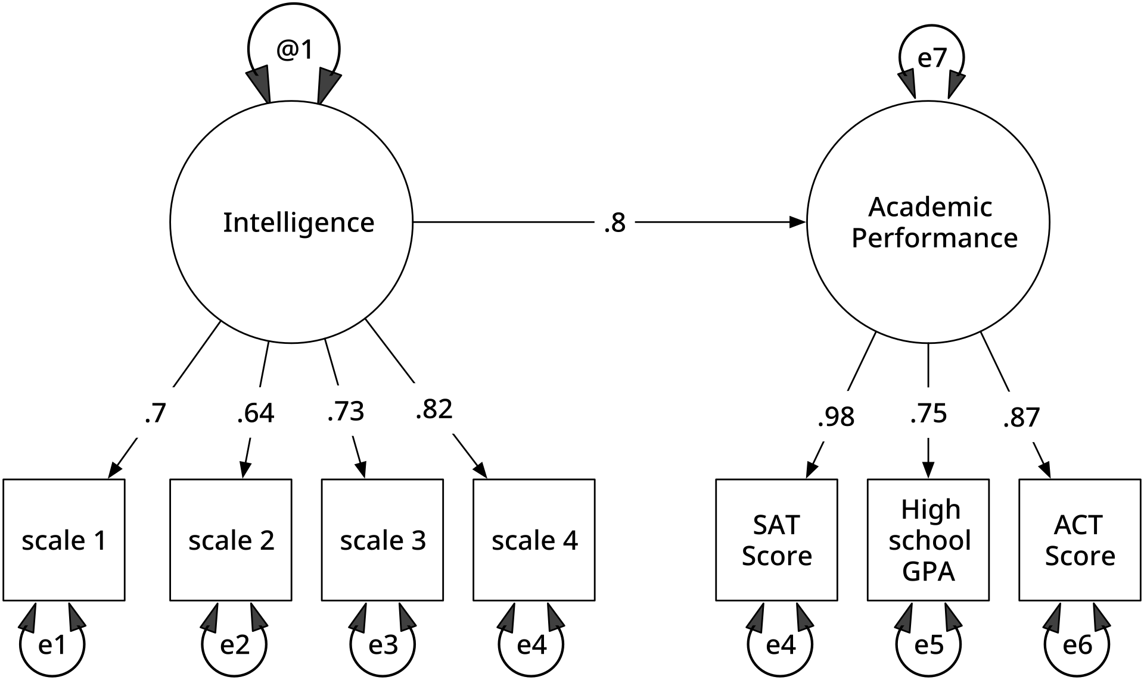
Other advanced methods
6
A few you could look into, when you gain more experience:
Probabilistic bias analysis: use simulations to estimate a bias parameter
Structural equation modelling (SEM): if you have a full theoretical model, SEM can be used to represent (and confirm) more complex causal relations among multiple variable (including latent ones)

Slide 56

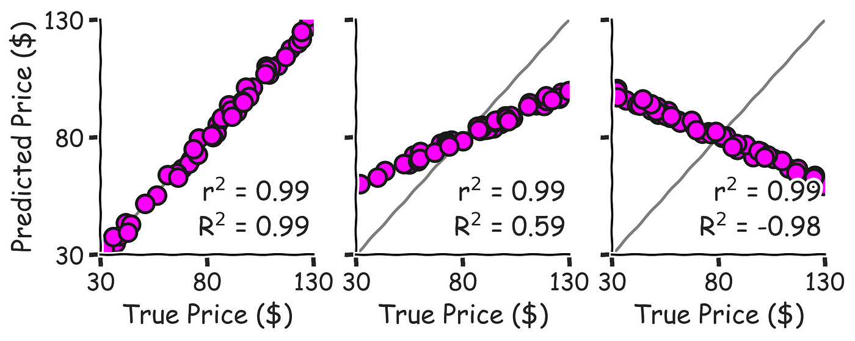

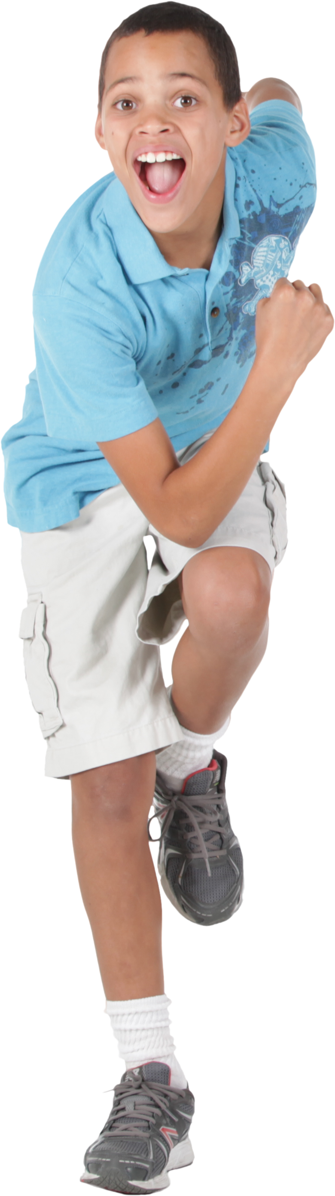


Statistical inference? In 2024? lol
“But Dimitri, idc about coefficients, I just want accurate predictions and HUGE metrics. So that involves INCLUDING. EVERY. VARIABLE”
😤😤😤
💸
💸 💸 💸 💸 💸
🚀
💸
Notes:
Well, that is fair. A lot of DS are mainly interested in making good predictions, choosing the best type of model and hyperparameters to optimise some metrics, etc. etc. You can have biased coefficients, but still have very good predictions with your model.

Slide 57
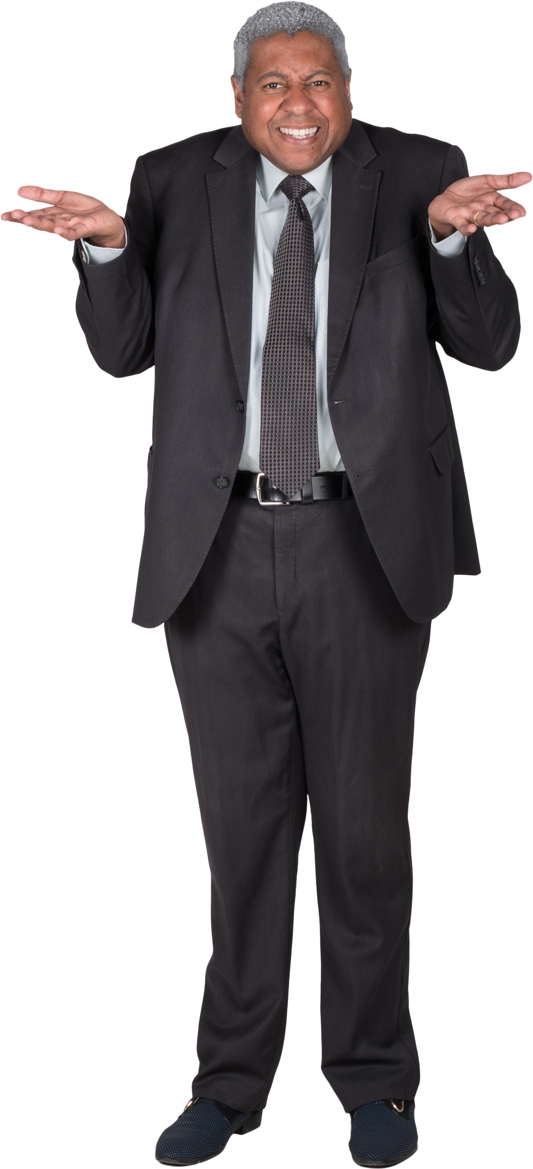
Causality in predictive ML
Ask a ML engineer how he takes into account endogeneity in his modelling
Them:
It’s a valid question though: if your outcome is well measured and you only care about good predictions, why should you care about bias in your regressors?
haha
Notes:
Story about that lecturer who had no idea what it was
Or: why should you even try to understand your model if you only care about good

Slide 58
Rethinking true values
Studying bias in statistics has been fairly established and researched for decades
It makes sense: you use statistics to better understand reality and take decisions, so if you can’t accurately model the “true” values, what is the point of your work?
Since the beginning of the class, we have never questioned these “true” values:
We take it as given that we should predict them
But should we always?
Notes:
There is some obsession in data science about perfectly predicting values as they are in the data.

Slide 59
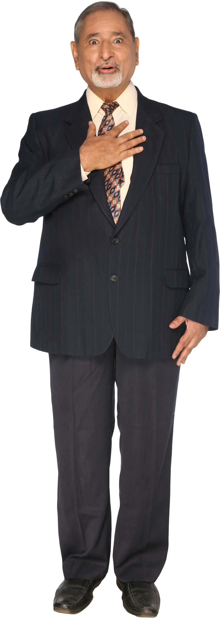
Warning
We will talk about fairness
This is a normative concept, what I think is fair may not be fair for you, and vice-versa
Also, I often argue data science is inherently political:
The data you work on can be people (my work does), or directly affect people’s needs or lives (my work also does)
The decisions you take in your analyses can often be subjective or prone to errors
The results you give decision-makers help them make (hopefully informed) decisions that ultimately affect people’s lives
Notes:
So this is the possibly controversial part of this course. The fact that it is political is something I imply quite heavy-handedly throughout the course when I talk about minorities, gender issues, etc. So don’t get shocked on me, right.
Fun stuff with data science: warfare, tracking and surveillance, face recognition, obscure recommandation algorithms that maximise the time you spent on a product (and not your well-being), advertisements, hiring, policing, deepfakes, social scoring systems

Slide 60
The state of fairness
To my knowledge, nobody talks about it in courses: not at the AMSE, not in the previous version of this class, not in engineering schools or in Data Science courses
At most you hear platitudes by engineers like “our models should not discriminate based on X or Y characteristics”
The subject of fairness is fairly recent, I discovered everything here recently, as I researched it in books
Here, mostly Fairness and Machine Learning: Limitations and Opportunities
Notes:
Tbh, knowing about fairness won’t land you a job. I don’t think most DS people truly care.
Also, pessimistic me would argue that most of what companies say about fairness in their ML algorithms is mostly posturing, unless they are under regulatory constraints or under high public scrutiny.

Slide 61
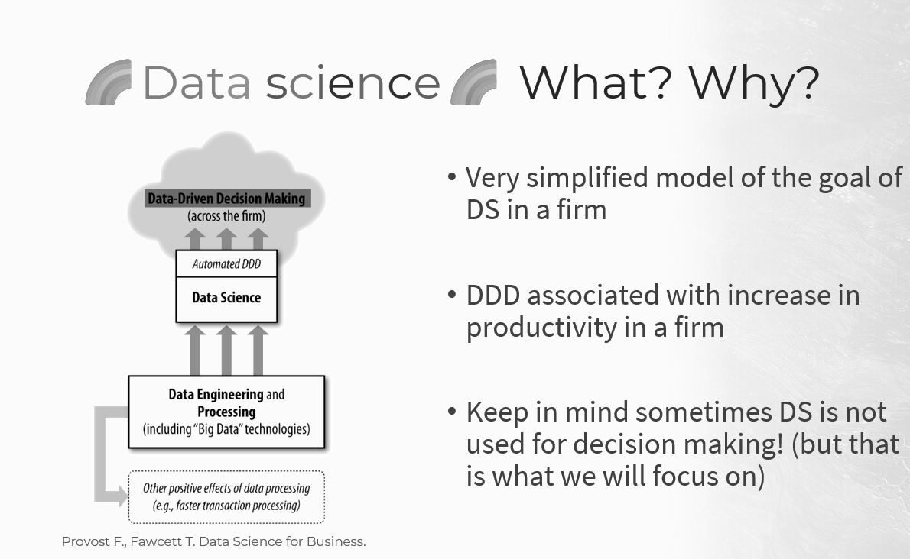
Ground truths and feedback loops
Notes:
First graph of the class (that I did not like). There are a few crucial things missing there.

Slide 62
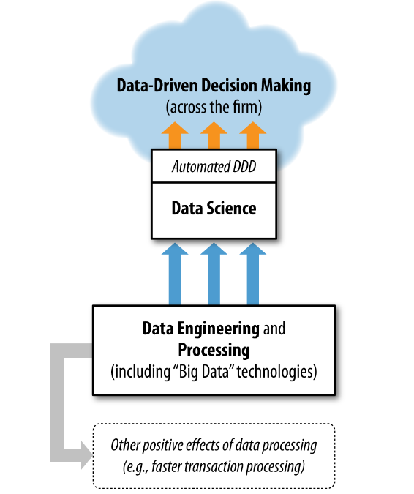
Ground truths and feedback loops
Action
Feedback
Ground truth
(or raw data)
Provost F., Fawcett T. Data Science for Business.
Notes:
This graph is very “firm” centric, like if it has no connection to the rest of the world, there is no context around it.
The action taken by the decision-maker (be it a human or a machine) does not exist in a vacuum. It has an effect on the ground truth that you observe and gather data from. That is called feedback. A feedback loop

Slide 63

Toy example: hiring people (1)
We are a company in a fictional world where people are either:
or
Hiring is made on the basis of predicted job performance, which we predict very well using ML and the following variables:
GPA (i.e. average grades during your studies)
An interview score
We have a minimum threshold of predicted job performance to hire people, this is an automatic process (a.k.a. “automated decision making”)
Notes:
Automated decision making, and also “decision support tool”, are very common. I create this for emergency services.
Also, example of COMPAS (Correctional Offender Management Profiling for Alternative Sanctions), is an algorithm in the US to predict a defendant’s likelihood to become a recidivist.

Slide 64
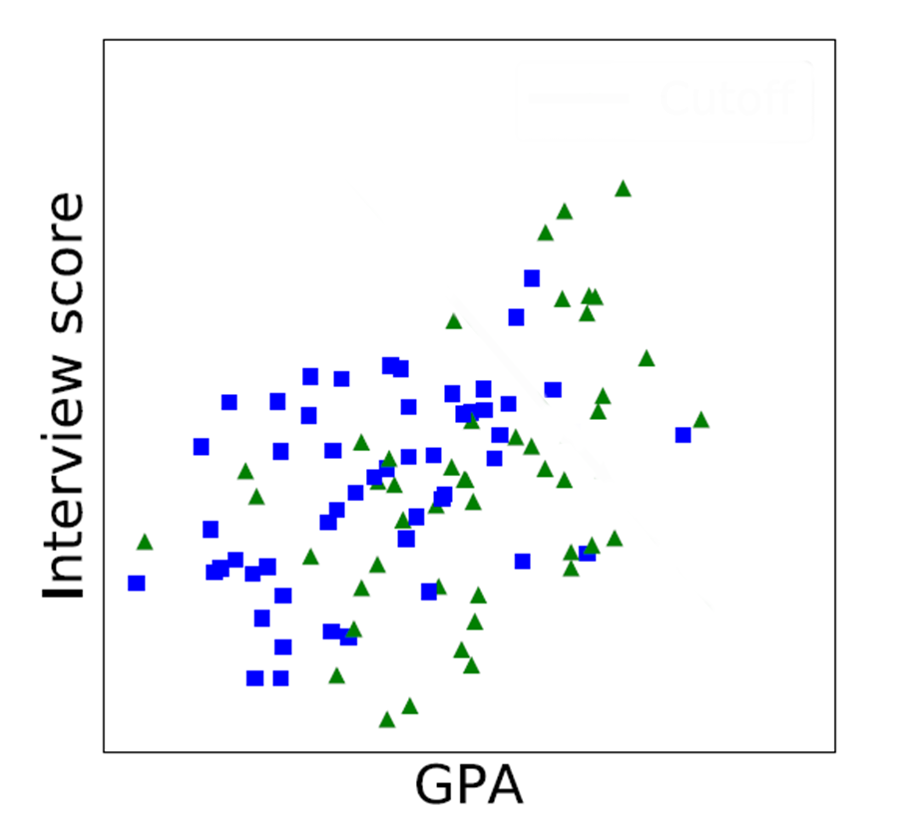
Toy example: hiring people (2)
This is a scatter plot of GPA and interview score
tend to have lower GPA, on average
Notes:
Why? Perhaps there is significant economic disparities between blues squares and green triangles, leading the former to worse educational outcomes.

Slide 65
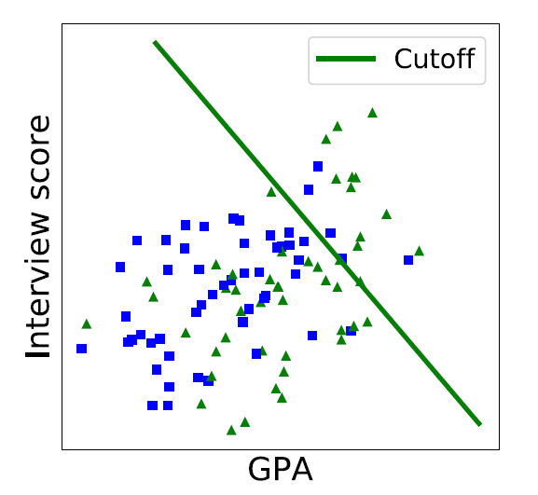
Toy example: hiring people (3)
This is a scatter plot of GPA and interview score
tend to have lower GPA, on average
The green line is the cutoff: anybody to the right can be hired
are less likely to be hired, overall

Slide 66
Toy example: hiring people (4)
Is it fair?
On one hand, this is what you get in the data, the “ground truth”, and you don’t include being a blue square or a green triangle in your model
On the other hand, there is an indirect effect of being a blue square on being hired through GPA (it’s a proxy!)
Notes:
So, on average, when being born blue, you can expect a lower chance of being hired. Because being blue places you in different “structural circumstances”: you are subject to a series of circumstances and decisions throughout your life which accumulate and coumpound.

Slide 67
Toy example: hiring people (5)
Imagine if every company started using the same methodology
Perhaps you could expect future applicants, in years, to change because of these hiring practices
That would be a feedback loop
Notes:
E.g. : even more economic disparity, leading to lower GPA among blue squares. That is kind of the idea behind systemic or institutional discrimination.
In turn, this reinforces the implicit discrimination in our model even more. The idea of a feedback loop: your decisions or output have an impact on the ground truth, ground truth which you then model again, etc. etc.
Feedback loop: that’s the same current problem with generative AI.

Slide 68
The state of society
Society is inherently rife with imbalances
Sample of occupations in the United States
More women
More men

Slide 69
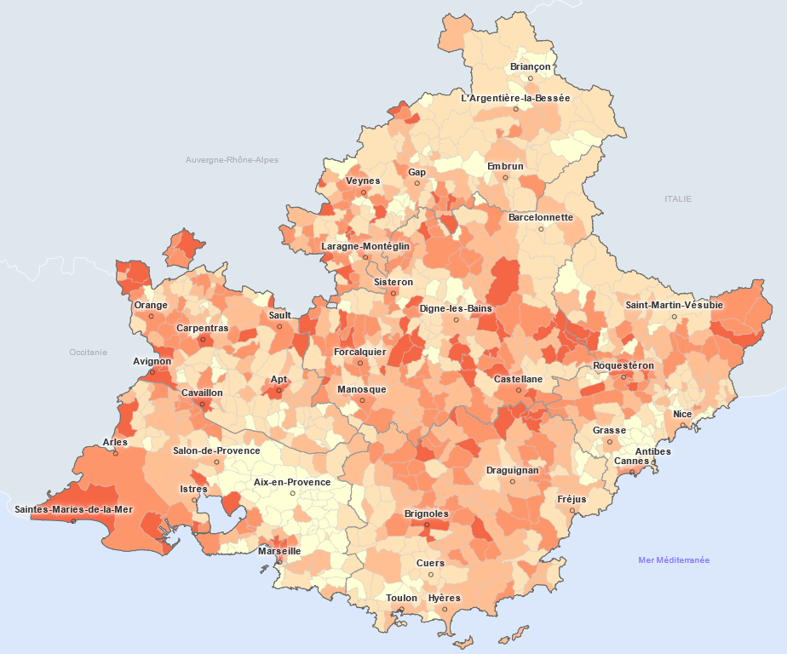
The state of society
Society is inherently rife with imbalances
Socioeconomic deprivation level
Low
High

Slide 70
The state of society
These become properties of the datasets they populate
Depending on what you model, you may end up reinforcing these imbalances, biases, stereotypes or categorisations
Notes:
Imbalance: unequal representation of different groups
Bias: incorrect associations stemming social and historical prejudice
Stereotype: associations that reflect a property of the world that is thought to be the result of social and historical prejudice
Categorisation: assigning discrete labels to complex aspects of identity such as gender and race

Slide 71


The COMPAS example
dun dun
Decision support tool, used in some US courts, that predicts recidivism and misconducts among defendants
Proprietary (i.e. closed source) statistical model behind it
Multiple scores are calculated according to criminal history, education, substance use…
Defendants are then categorized as low, medium or high risk, for ease of interpretation
2016 study:
ProPublica (investigative journalism org.) showing a higher rate of false positives of violent recidivism among black defendants (vs. white defendants)
Notes:
Correctional Offender Management Profiling for Alternative Sanctions
Recidivism, among other things
Misunderstanding of statistical

Slide 72

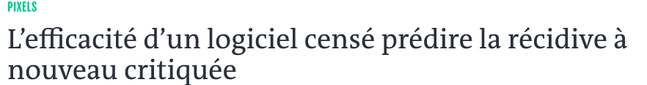
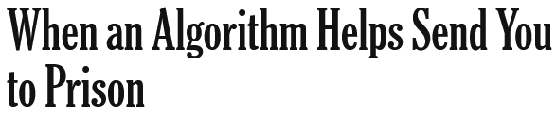
Significant controversy
Multiple articles in mainstream media (Le Monde, Libération, NYT, WaPo…)
Original study cited around 4,000 times (Google Scholar)
Still an ongoing subject of study among academic circles
This is problematic indeed:
Is the algorithm truly fair, even if race is not a factor? How do we define fairness?
I would add: do decision makers understand how predictions are made, and the limits of such models and scoring? Very complicated model can appear deceivingly simple
Notes:
Correctional Offender Management Profiling for Alternative Sanctions
Recidivism, among other things
Misunderstanding of statistical

Slide 73
So what’s fairness?
We will instead define unfairness (or discrimination):
It’s a treatment that “systematically impose a disadvantage on one social group relative to others”.
Level | Direct discrimination | Indirect discrimination
Structural/societal | Laws against same-sex marriage | Better funded schools in wealthier, more segregated areas
Organisational | Lack of disability accommodations | Networked hiring
Interpersonal | Overt prejudice | Belief in need for innate brilliance (combined with gender stereotypes)
Problem: this deprives prejudiced groups of opportunities
Notes:
Sociologists distinguish three different levels:
Highest level: how society is organised
Organisational/groups:
Brilliance: in some very traditional sociocultural contexts,

Slide 74
Equality of opportunity
An approach to limit discrimination (with three competing views):
Score | Goal | Intervention point | Who bears the cost of uplifting historically disadvantaged groups
Narrow | Ensure people who are similarly qualified for an opportunity have similar chances of obtaining it | Decision making | No one
Middle | Discount differences du to past injustice, that account for current differences in qualifications | Decision making, especially critical life opportunities | Decision maker, who may pass on the cost to decision subjects
Broad | Ensure people of equal ability and ambition are able to realize their potential equally well | Government, on a continuous basis | Taxpayers

Slide 75
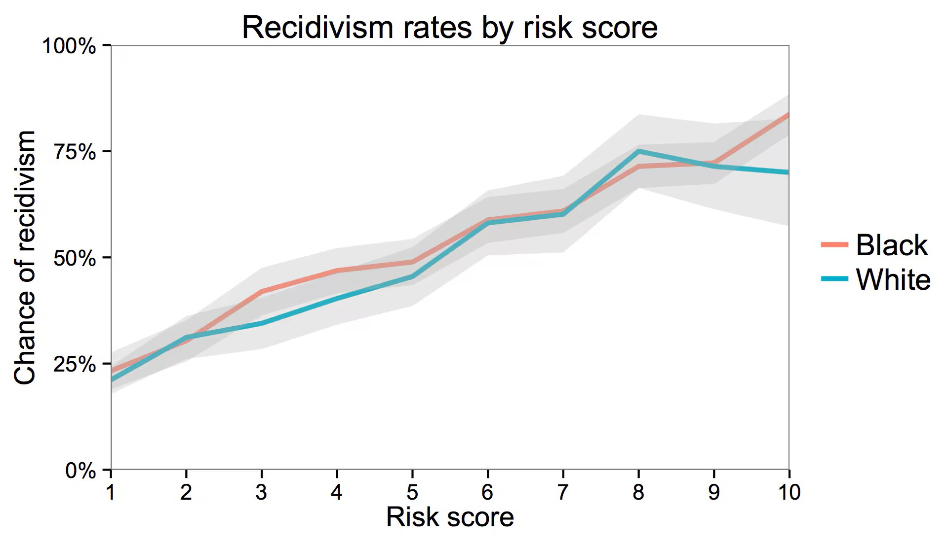
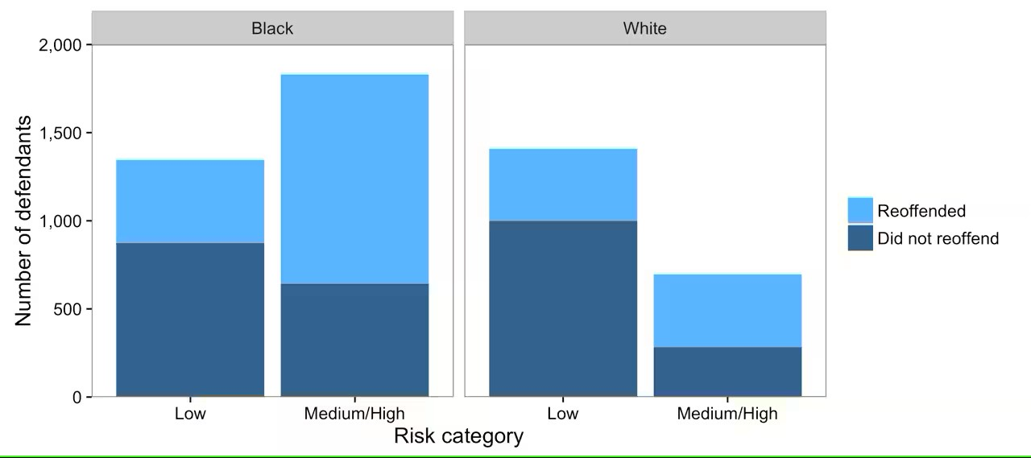
And in statistics? (1)
That’s… complicated. Let’s look at COMPAS again:
“Our algorithm is fair, positive predictions are equal among groups”
“The algorithm is not fair, false positive rates are unequal among groups”

Slide 76
And in statistics? (2)
There are many fairness metrics, but no single best
Plus, some are conflicting
The authors of Fairness and Machine Learning seem to mainly emphasize error rate parity
Having similar true positive rates is desirable of course
But false positives and false negative also have significant real-life implications
Ultimately, the metrics you will use depends on your project
Sorry! (:
Some resources to learn about metrics: Fairlearn, Fairness and Machine Learning, Fairness Definitions Explained

Slide 77
Advocating for interpretability and causality in ML
Complex, black box ML algorithms are very good at prediction, so much that they tend to preserve structural (dis)advantages, because these exist in the data
Causal inference help identify if decisions are taken according to legitimate factors, instead of spurious correlations
Also, help identify how sensitive attributes matter in prediction, either directly or indirectly, and to create “what-if?” scenarios
Interpretability help identify how predictions affect groups
Do different groups have different outcomes on average?
Are errors in predictions comparable across groups? (error rate parity)

Slide 78
Read the book!
Again, I can’t recommend enough the Fairness and Machine Learning book
It goes deep into the subject of fairness in Data Science and decision making, and this (small) chapter does not do it justice
Great for anybody who would like to think critically about the impact of Machine Learning and data-driven decision making on people, the perpetuation of societal inequalities, etc.

Slide 79
Next time
No lab about this chapter
I haven’t identified something general and useful enough for you to work on
Next time: interpretability and communication
Class in the morning
Lab in the afternoon
So take your laptop if you can

